Slide 1
Replicating Time Series Returns of Five Factors Based on Fama & French (2014)
Prepared By: Udit Gupta

Slide 2
Contents
Overview
Results
New Factors Introduced
Factor Components
Appendix

Slide 3
Overview
In this analysis we replicate the 5 factors, viz.:
Market
Size
Value
Profitability, and
Investment
This is based on 2014 paper by Fama and French, titled ‘A Five-Factor Asset Pricing Model’
For the period between July ’68 – Dec ‘14, we find our results to be consistent with those published on Kenneth French’s website⁽¹⁾
Note:
(1) http://mba.tuck.dartmouth.edu/pages/faculty/ken.french/data_library.html accessed on June 19, 2015.

Slide 4
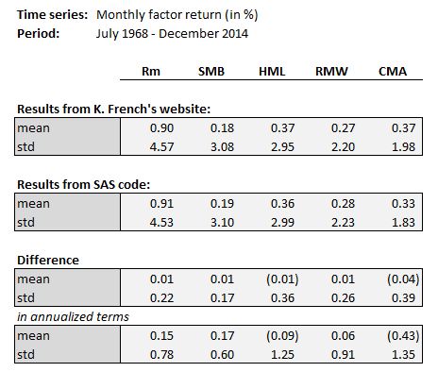
Results
Comparison of results with data from French’s website
Factors are as follows:
Rm | Market returns
SMB | Size: Small minus Big
HML | Value: High minus Low
RMW | Profitability: Robust minus Weak
CMA | Investment: Conservative minus Aggressive

Slide 5
New Factors Introduced
Proxy variables for the two new factors introduced in this paper:
Profitability = (Revenue – COGS – Interest Expense – SG&A) / Book Equity⁽¹⁾
Investment = ΔTotal Assets / Total Assets⁽²⁾
Breakpoints used:
Value, Profitability, Investments – 30%/70% percentiles
Size – 50% percentile
Portfolio of stocks are sorted independently on each of the variables, and 6 sub-portfolios are constructed for each of the following categories:
Size & Value
Size & Profitability, and
Size & Investment
Note:
Value of Book Equity from financial year T is used to scale the values for financial year T
Value of Total Assets from financial year T-1 is used to scale the ΔTotal Assets between financial year T-1 and T

Slide 6
Factor Components
Factor | Factor Components
HML | (1/2)*(Small Value + Big Value) – (1/2)*(Small Growth + Big Growth)
RMW | (1/2)*(Small Robust + Big Robust) – (1/2)*(Small Weak + Big Weak)
CMA | (1/2)*(Small Conservative + Big Conservative) – (1/2)*(Small Aggressive + Big Aggressive)
SMB SMB_{B/M} SMB_{OP} SMB_{INV} | (1/3)*(SMB_{B/M} + SMB_{OP} + SMB_{INV}), where (1/3)*(Small High + Small Neutral + Small Low)/3 – (Big High + Big Neutral + Big Low) (1/3)*(Small Robust + Small Neutral + Small Weak)/3 – (Big Robust + Big Neutral + Big Weak) (1/3)*(Small Conser. + Small Neutral + Small Aggress.)/3 – (Big Conser+ Big Neutral + Big Aggress)
By construction, HML, RMW & CMA are roughly neutral with respect to size
However, they are not neutral to each other – which implies that average factor return is a mix of premiums related to itself and the other two factors

Slide 7
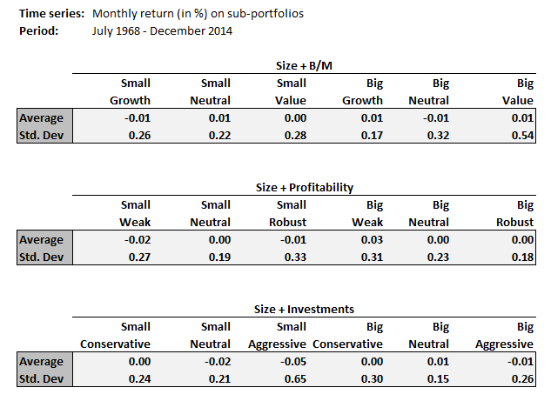
Appendix I: Comparison of Sub-Portfolio Returns
In addition to the monthly return series on factors, we also compared the return series on factor component portfolios
The results were consistent with those published on Kenneth French’s website (see the table on the right)
Difference in SAS output vs. results on French’s website

Slide 8
Appendix II: Comparison of Break-Points Used
The calculated breakpoints were consistent with those published on French’s website for the period since 1968
For period prior to that, we find that number of stocks available in our dataset are, at times, considerably lower than those used for data on French’s website
Hence, we have compared all our results from July 1968 onwards
Number of stocks available for calculating Profitability break-points
Period not considered for comparison due to lack of data

Slide 9
End

